Slide 1

Problem Solving Session
The remainder of today’s class will comprise the problem solving session (PSS).
Your instructor will divide you into teams of 3 or 4 students.
Each team will work together to solve the following problems over the course of 20-30 minutes.
You may work on paper, a white board, or digitally as determined by your instructor.
You will submit your solution by pushing it to GitHub before the end of class.
Your instructor will go over the solution before the end of class.
If there is any time remaining, you will begin work on your homework assignment.
Class participation is a significant part of your grade (20%). This includes in class activities and the problem solving session.
Your graders will grade your participation by verifying that you pushed your solutions before the end of the class period each day.

Slide 2

Problem 1
C:
D:
Assume that each of the following is an absolute path to a file in your file system. Draw the tree that represents the structure in the space on the left.
You may use the provided icons, or you may draw the diagram on paper or a whiteboard and insert a photo or scan to the left.
Users
Program Files
Games
stuff.txt
Ron
Harry
WoW
SoftDevI
Documents
todo_list.txt
C:\Users\Ron\Documents\biography.txt
C:\Users\Ron\SoftDevI\Week01\homework.txt
C:\Users\Harry\todo_list.txt
C:\Program Files\Python\python.exe
C:\Program Files\Git\git.exe
D:\Games\WoW\wow.exe
D:\stuff.txt
wow.exe
Week01
biography.txt
Python
Git
homework.txt
python.exe
git.exe
Remember, every team member should record the answers in their own copy of the packet.

Slide 3
Problem 2
Name: Matthew Repecki | Prior Experience (0-10): 4.5
Comments: I did some C++, Java, a tiny bit of Python, JavaScript, and basic Web Programming. I know the most of Java which I got up to basic Object Orientated Programming
Spend a few minutes talking with your team members about your prior experience programming.
Rate yourselves on a scale of 0 (very little or no experience) to 10 (I should be teaching this class!).
Fill out the tables with each of your answers.
Name: Ife Adetunji | Prior Experience (0-10): 3.0
Comments: I only have experience with C++ and a little bit of Java. I also took a computer science dual enrollment class in high school.
Name: Zoe Bingham | Prior Experience (0-10): 3
Comments: Have taken classes in Java, C++, and Python in High School.
Software Development & Problem Solving is designed for students of all levels of experience. Don’t worry if you feel like you are a 0 or a 10.
If you need more space, duplicate this slide.

Slide 4
Problem 2
Name: Joe MacDonough | Prior Experience (0-10): 8.5
Comments: Took AP Computer Science junior year, have experimented with Ludwig Artificial Learning, have done many projects using python and java networking APIs, used both java and C++ to create 2d and 3d games, made a proxy server with PHP
Spend a few minutes talking with your team members about your prior experience programming.
Rate yourselves on a scale of 0 (very little or no experience) to 10 (I should be teaching this class!).
Fill out the tables with each of your answers.
Name: JT Novitsky | Prior Experience (0-10): 2
Comments: Took a python class sophomore year of high school, learned C++ over the summer through RIT
Software Development & Problem Solving is designed for students of all levels of experience. Don’t worry if you feel like you are a 0 or a 10.
If you need more space, duplicate this slide.

Slide 5
Problem 3
1. Opens new_file.txt in Notepad
2. Adds new_file.txt to Github
3. Commits to local repository as "adding new file"
4. Uploads to Github
5. New changes have not been save locally or remotely yet
Consider the following commands executed in a Git repository on your computer. Together with your team, describe the status of the file at each step.
notepad new_file.txt
git add new_file.txt
git commit -m "adding a new file"
git push
notepad new_file.txt (add text)

Slide 6
Problem 4
1. To view committed files and what is about to be uploaded
2. Create a new repository in order to have a place to keep your code AND keep track of version history
3. Push code to Github once the code works
4. Pull code from Github
Discuss the following questions with your team, and type or write your answers in the space on the right.
Why do you think that it is a good idea to check the status before staging files?
When starting a brand new assignment, what is the first thing you should do, and why?
What is the last thing that you should do before taking a break from working?
Assume that you are getting back to work after taking a break. What is the first thing you should do?

Slide 7
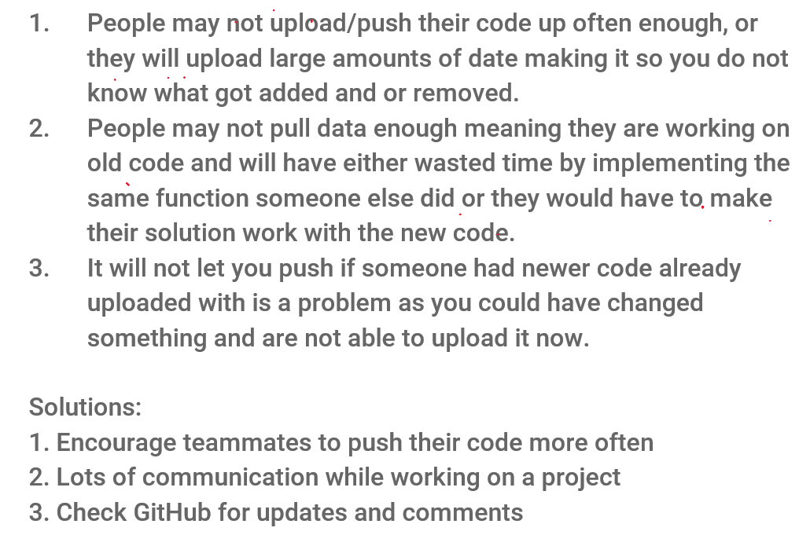
Problem 5
Consider that the same remote repository may be used from more than one computer, e.g.:
You may work on a lab computer in the classroom, but your laptop in your dorm.
You may work on a team where each team member uses their own computer.
Working together with your team, brainstorm the problems that you may encounter working this way. List as many as you can think of.
Can you come up with a solution for any of these problems?

